Slide 1


SLIDE 01
social engineering IN CYBER SECURITY
PSYCHOLOGICAL TACTICS AND DEFENSE MECHANISMS
A Research-Based Analysis of Human Vulnerabilities and Countermeasures

Slide 2

SLIDE 02
Quick poll
Have you ever clicked a suspicious
link?
Received a your package is
waiting text?
Been asked to verify a password using
an email?
Know someone who got scammed?

Slide 3

SLIDE 03
SOCIAL ENGINEERING : the human factor
Social engineering exploits human psychology, not systems
91% of attacks involve social engineering
Phishing → 36% of breaches
Key tactics: authority, urgency, fear, reciprocity, scarcity
Human vulnerabilities: cognitive biases, personality, stress, culture
Current defenses weak when used alone
Proposed: Psychological Resilience Cybersecurity Framework (PRCF)
Expected reduction in attacks: 52–70%

Slide 4
SLIDE 04
INTRODUCTION
Human behavior = biggest cybersecurity weakness
COVID-19 dramatically increased phishing
Technical security cannot stop users from being manipulated
Need for combined psychological + technical defense

Slide 5
SLIDE 05
RESEARCH PROBLEM
Training too generic
Psychological manipulation misunderstood
Human differences not considered
Need for human-centered defense strategies

Slide 6
SLIDE 06
RESEARCH METHODOLOGY
10 REVIEWED PAPERS
ANALYSIS OF 2021-2025 PUBLICATIONS
4 MAJOR CASE STUDIES
FRAMEWORK DEVELOPMENT
REAL WORLD CYBER ATTACK ANALYSIS
CREATION OF THE PRCF MODEL

Slide 7
SLIDE 07
PSYCHOLOGICAL TACTICS (Cialdini Principles)
Authority – 68%
Urgency – 67%
Scarcity – 41%
Reciprocity – 34%
Social Proof – 23%
Commitment/Consistency – 29%

Slide 8

SLIDE 08
Emotional Manipulation
Fear (52%)
Curiosity (38%)
Trust exploitation (44%)
Dual tactics → 61% success rate

Slide 9

SLIDE 09
Human Vulnerabilities
PERSONALITY
Neuroticism ↑ 56% risk
Agreeableness ↑ 38% risk
Openness & conscientiousness ↓ risk
DEMOGRAPHICS
Age 18–25 ↑ 32% risk
Executives ↑ 37% risk
Higher education ↓ 26% risk

Slide 10
SLIDE 10
SITUATIONAL FACTORS
Multitasking ↑ 89% susceptibility
Stress ↑ 67%
Victims spent 68% less time verifying details (eye-tracking)
Afternoons = higher vulnerability
Organizational Factors
Strong security culture ↓ attacks by 61%
Blame culture → underreporting
Overworked employees ↑ 41% vulnerability
Siloed departments ↑ 43% risk

Slide 11
SLIDE 11
COVID -19 WHO SCAM
500,000 + VICTIMS
$50M+ LOSSES
TACTICS: fear+authority+urgency
TWITTER BITCOIN SPAM
HACKED ACCOUNTS: OBAMA,MUSK,GATES
$118k stolen in hrs
TACTICS: authority, reciprocity, social proof
Challenges in the Digital World
REAL WORLD ATTACK CASE STUDIES

Slide 12


SLIDE 12
UBIQUITI NETWORKS
$ 46.7M STOLEN
$8M RECOVERED
LESSON: VERIFY FINANCIAL REQUESTS
ANTHEM HEALTHCARE BREACH
78.8M RECORDS BREACHED
$115M SETTLEMENT
LESSON: sector specific vulnerabilities
Challenges in the Digital World
REAL WORLD ATTACK CASE STUDIES

Slide 13
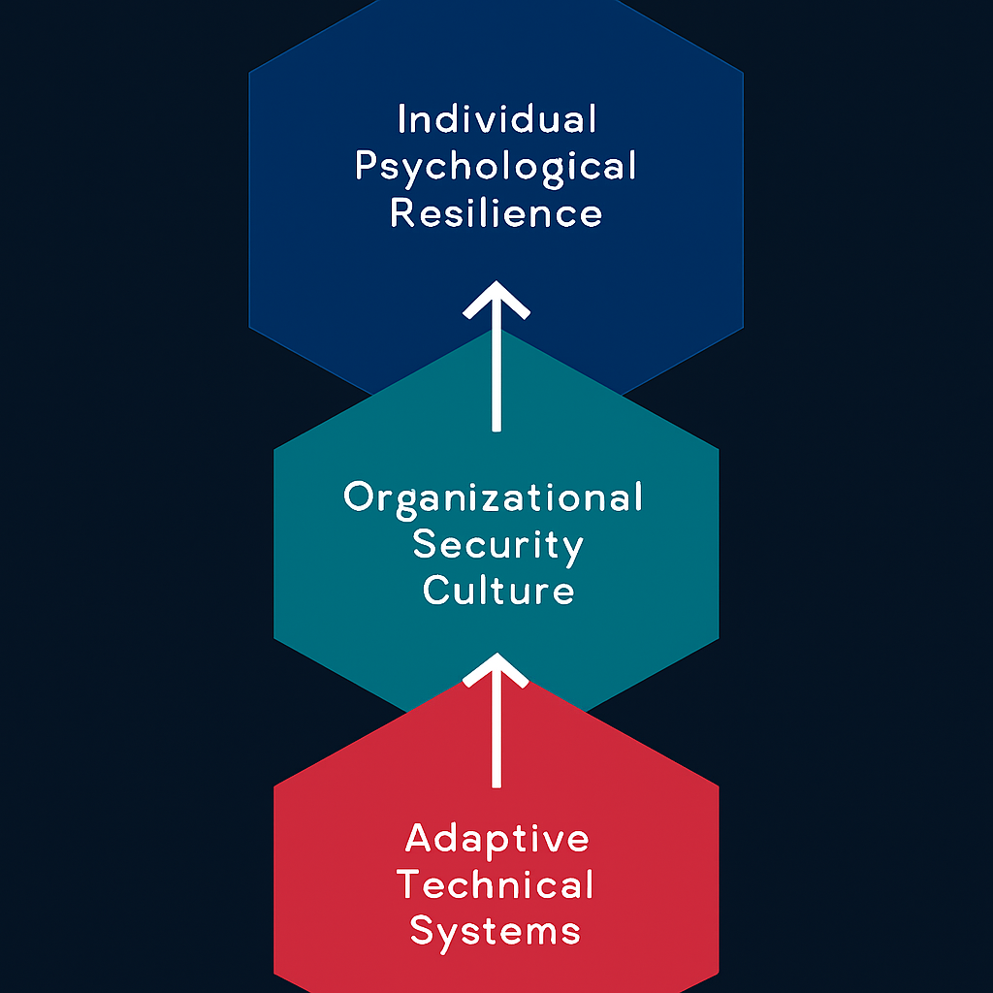
SLIDE 13
prcf framework
Building security resilience through integration
Comprehensive Approach
The PRCF framework integrates human, organizational, and technical factors, aiming to create a holistic approach to security resilience that strengthens defenses against potential threats.

Slide 14
SLIDE 14
prcf framework
THE PRCF FRAMWORK COMBINES 3 CRUCIAL ELEMENTS FOR ROBUST DEFENSE
LAYER 01
LAYER 02
LAYER 03
INDIVIDUAL RESILIENCE
ORGANIZATIONAL CULTURE
ADAPTIVE TECHNOLOGY
focusing on cognitive bias and strategies like
STOP-THINK-VERIFY
encouraging leadership modeling and blame free
reporting
using ai detection
and real time
feedback for
advanced protection

Slide 15
SLIDE 15
IMPLEMENTATION ROADMAP
Phase 1: Assess
Phase 2: Build foundation
Phase 3: Continuous operation
Phase 4: Evaluation & updates

Slide 16
SLIDE 16
RECOMMENDATION FOR INDIVIDUALS
RESULTS
Enable MFA
Verify before acting
Pause 10 seconds before clicking
Use password managers
Stay aware of latest scams
Personalized training + technical controls = 52–70% reduction
Strong culture = 61% fewer attack successes
Most effective defense = combined psychological + technical

Slide 17
SLIDE 17
CONCLUSION
Attackers exploit psychology
Humans are key defenders
continous training is essential
prcf: 50-70% security improvement

Slide 18
SLIDE 18
KEY ACTIONS TO TAKE
multi factor authentication
verify before clicking
confirm unusal requests
verify sender’s adress
THANKYOU
Wishing you gentle browsing and secure days

